Slide 1
Introduction to enlargements
Transformations

Slide 2
how to use Oak lessons

Slide 3
I can understand the nature of enlargements and appreciate what changes and what is invariant.

Slide 4
Enlargement is a transformation that causes a change of size.
Two shapes are similar if the only difference between them is their size. Their side lengths are in the same proportions.

Slide 5

Introduction to enlargements
Understanding enlargement
Understanding similarity

Slide 6
Understanding enlargement
object
image
enlargement
object
image
enlargement
Enlargement is a transformation that causes a change of size.
The change in size could be a stretch or a shrink.

Slide 7
Understanding enlargement
Enlarging a shape does not affect the size of the angles.
Example:
30°
30°
60°
60°
Angles are invariant during enlargement.

Slide 8

Understanding enlargement
What type of transformation has occurred?
object
image
enlargement
reduction
rotation
reflection

Slide 9
Understanding enlargement
What type of transformation has occurred?
image
object
enlargement
reduction
rotation
reflection

Slide 10
Understanding enlargement
Which property is always invariant during enlargement?
lengths
angles
areas

Slide 11
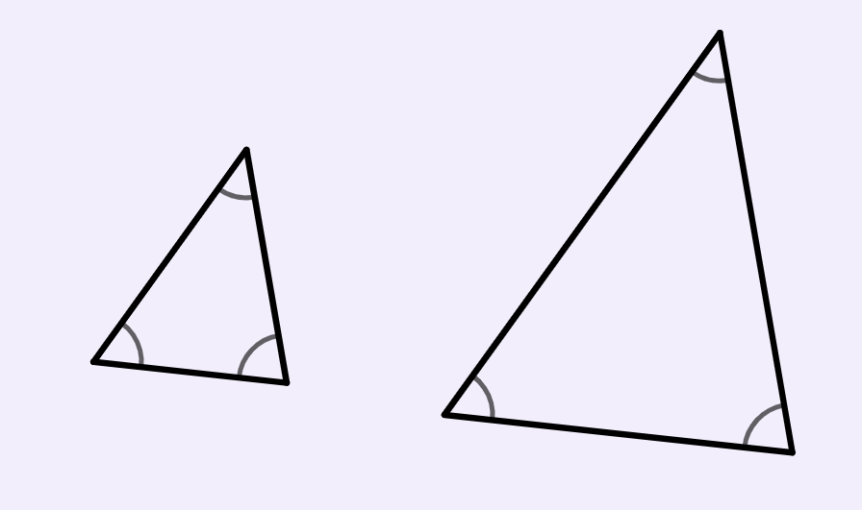
Understanding enlargement
The object has been enlarged to create the image.
What is the size of the angle marked?
44°
?
object
image
44°
60°
74°

Slide 12
Understanding enlargement
1) Write true or false for each statement.
a) Enlargement only refers to when a shape increases in size.
b) The image may have different lengths to the object after an enlargement.
c) The image may have different angles to the object after an enlargement.
d) The image can be smaller than the object after an
enlargement.

Slide 13
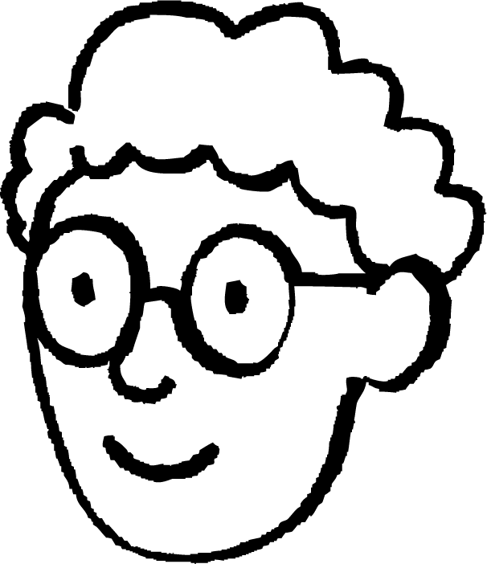
Understanding enlargement
2) Alex is going to enlarge the parallelogram to double the size.
35°
He thinks that the corresponding angle in the image will be 70°.
Do you think he is correct? Justify your answer.

Slide 14
Understanding enlargement
1) Write true or false for each statement.
a) Enlargement only refers to when a shape increases in size.
False
b) The image may have different lengths to the object after an enlargement.
True
c) The image may have different angles to the object after an enlargement.
False
d) The image can be smaller than the object after an
enlargement.
True

Slide 15
Understanding enlargement
2) Alex is going to enlarge the parallelogram to double the size.
35°
He thinks that the corresponding angle in the image will be 70°.
Do you think he is correct? Justify your answer.
No, Alex is not correct because…
enlarging a shape does not cause the angles to change size
the corresponding angle will be 35°

Slide 16
Introduction to enlargements
Understanding enlargement
Understanding similarity

Slide 17

Understanding similarity
Here is a photograph of Lucas.
Below are three larger versions of the photograph.
Why does Lucas’s face look distorted in the first two images but not in the third?
The third image is similar to the original photograph.

Slide 18

Understanding similarity
Two shapes are similar if the lengths are in the same proportions.
Example:
2 cm
4 cm
× 3
6 cm
× 3
12 cm
The rectangles are similar because the multipliers within each shape are equal.

Slide 19
Understanding similarity
Two shapes are similar if the lengths are in the same proportions.
Example:
× 2
2 cm
4 cm
6 cm
12 cm
× 2
The rectangles are similar because the multipliers between each shape are equal.

Slide 20
Understanding similarity
Two shapes are similar if the lengths are in the same proportions.
Non-example:
2 cm
6 cm
6 cm
× 3
× 2
12 cm
The rectangles are not similar because the multipliers within each shape are not equal.

Slide 21
Understanding similarity
Two shapes are similar if the lengths are in the same proportions.
Non-example:
× 3
2 cm
6 cm
6 cm
× 2
12 cm
The rectangles are not similar because the multipliers between each shape are not equal.

Slide 22
Understanding similarity
Which triangle is similar to triangle A?
A
B
C
4 cm
× 3
× 3
12 cm
12 cm
3 cm
× 2
× 3
9 cm
6 cm

Slide 23
Understanding similarity
Which triangle is similar to triangle A?
A
B
C
9 cm
12 cm
12 cm
× 3
3 cm
× 3
× 2
4 cm
6 cm

Slide 24
Understanding similarity
Which rectangle is not similar to the object?
object
2 cm
4 cm
3 cm
1 cm
1 cm
6 cm
2 cm
3 cm

Slide 25
Understanding similarity
Enlarging a shape does not affect the size of the angles.
This means that corresponding angles in similar shapes are equal.
similar
not similar
4 cm
× 2
4 cm
× 3
37°
37°
3 cm
3 cm
53°
53°
8 cm
12 cm
37°
27°
× 2
× 2
6 cm
6 cm
53°
63°
Corresponding angles are equal.
Corresponding angles are not equal.

Slide 26
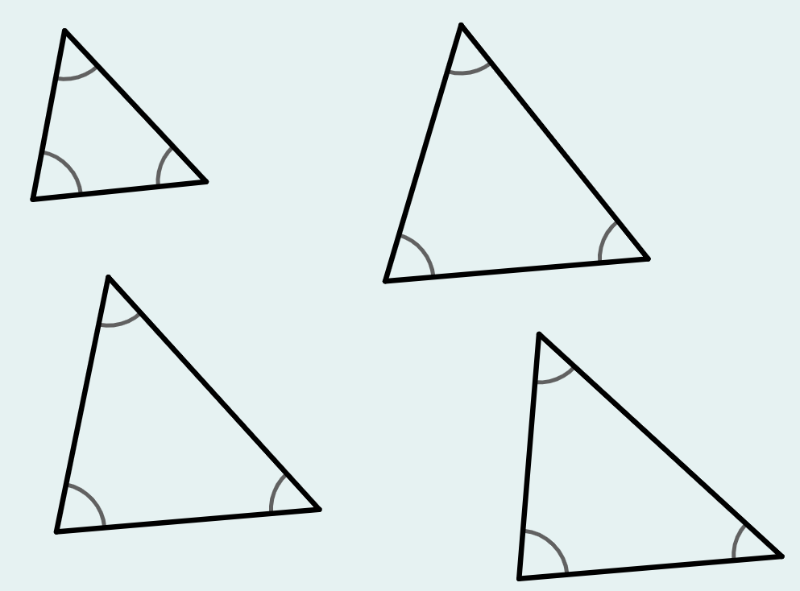
Understanding similarity
Which triangle is similar to the object?
object
54°
73°
53°
54°
54°
54°
71°
55°
73°
53°
75°
51°

Slide 27
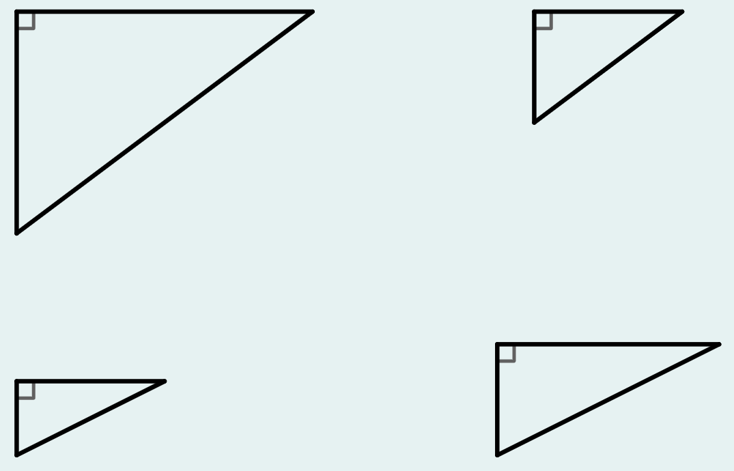
Understanding similarity
Which triangle has the same angles as the object?
object
6 cm
8 cm
6 cm
3 cm
4 cm
4 cm
3 cm
2 cm

Slide 28
Understanding similarity
1) Match the rectangles which are similar.
1 cm
3 cm
6 cm
12 cm
4 cm
10 cm
4 cm
12 cm
8 cm
2 cm
16 cm
5 cm

Slide 29
Understanding similarity
2) Use square paper to accurately draw the right-angled triangle below.
a) Draw another right-angled triangle that is similar to this one.
b) Cut out each triangle. Place one triangle on top of the other and match up one of the vertices. What do you notice?

Slide 30
Understanding similarity
1) Match the rectangles which are similar.
1 cm
3 cm
6 cm
12 cm
4 cm
10 cm
4 cm
12 cm
8 cm
2 cm
16 cm
5 cm

Slide 31
Understanding similarity
2) Use square paper to accurately draw the right-angled triangle below.
a) Draw another right-angled triangle that is similar to this one.
The base and height should be pairs of numbers obtained by multiplying 4 and 3 by the same number. Examples: 8 and 6, 12 and 9, 16 and 12, 20 and 15, 2 and 1.5
b) Cut out each triangle. Place one triangle on top of the other and match up one of the vertices. What do you notice?
Corresponding angles are equal.

Slide 32
Introduction to enlargements
Enlargement is a transformation that causes a change of size.
Enlargement can be a stretch or shrink.
Angles remain invariant when a shape is enlarged.
If two shapes are similar then their corresponding angles are equal and the lengths are in the same proportion.
When a shape is enlarged, the image is similar to the object.

Slide 33

© Oak National Academy 2023.
Produced in partnership with Mathematics in Education and Industry.
Licensed on the Open Government Licence v3.0, except where otherwise stated. See Oak terms and conditions.

